Slide 1

Virtual University
Human-Computer Interaction
Lecture 14
Interaction Frameworks and Styles
Imran Hussain
University of Management and Technology (UMT)
Notes:
1

Slide 2
In the Last Lecture
The Computer
Text Entry Devices
  Keyboard, different types
  Handwriting & Speech Recognition
Positioning, Pointing and Drawing
  Mouse and Touchpad
  Touch-sensitive Screens
Display Devices
  Bitmap screens (CRT & LCD)
  Digital paper.
Paper: Printing Scanning
Notes:
2

Slide 3
In Today’s Lecture
Interaction
  Models of Interactionn
Ergonomics
  physical aspects of interfaces
  industrial interfaces
Common Interaction Styles
  command line interface
  menus
  natural language
  question/answer and query dialogue
  form-fills and spreadsheets
WIMP Interface
Notes:
1

Slide 4

What is Interaction?
communication

Slide 5
Models of Interaction
terms of interaction
Norman model
interaction framework

Slide 6
Some Terms of Interaction
domain – the area of work under study
  e.g. graphic design
goal – what you want to achieve
  e.g. create a solid red triangle
task – how you go about doing it
– ultimately in terms of operations or actions
  e.g. … select fill tool, click over triangle
Note …
  traditional interaction …
  use of terms differs a lot especially task/goal !!!

Slide 7
Donald Norman’s Model
Norman’s model concentrates on user’s view of the interface
goal
execution
evaluation
system

Slide 8
7 Stages of Action
Goals
Intention to act
Evaluation of the
Interpretations
sequence of actions
Interpreting the perception
execution of
The action sequence
Perceiving the state
of the world
THE WORLD

Slide 9
Using Norman’s Model
Some systems are harder to use than others
Gulf of Execution
  user’s formulation of actions
  ≠ actions allowed by the system
Gulf of Evaluation
  user’s expectation of changed system state
  ≠ actual presentation of this state

Slide 10
Abowd and Beale Framework
extension of Norman…
their interaction framework has 4 parts
  user
  input
  system
  output
each has its own unique language
interaction ⇒ translation between languages
problems in interaction = problems in translation
O
output
S
core
U
task
I
input

Slide 11
Using Abowd & Beale’s Model
O
output
S
core
U
task
I
input
user intentions
→ translated into actions at the interface
→ translated into alterations of system state
→ reflected in the output display
→ interpreted by the user
general framework for understanding interaction
  not restricted to electronic computer systems
  identifies all major components involved in interaction
  allows comparative assessment of systems
  an abstraction

Slide 12
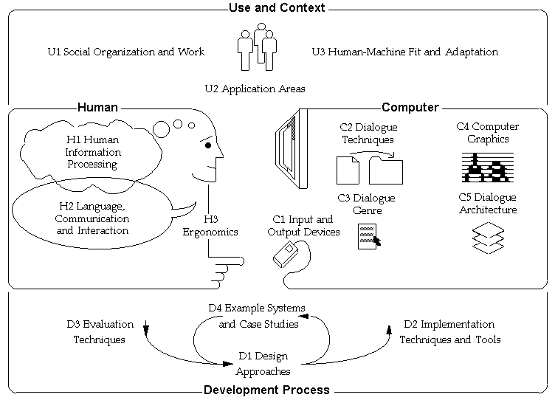
HCI and Frameworks

Slide 13
Ergonomics
physical aspects of interfaces
industrial interfaces

Slide 14
Ergonomics
Study of the physical characteristics of interaction
Also known as human factors – but this can also be used to mean much of HCI!
Ergonomics good at defining standards and guidelines for constraining the way we design certain aspects of systems

Slide 15
Physical Aspects of Interfaces
arrangement of controls and displays
  controls grouped according to function or frequency of use, or sequentially
surrounding environment
  seating arrangements adaptable to cope with all sizes of user
health issues
  physical position, environmental conditions (temperature, humidity), lighting, noise,
use of colour
  use of red for warning, green for okay,
  awareness of colour-blindness etc.

Slide 16
Industrial Interfaces
Office interface vs. industrial interface?
Context matters!
office industrial
type of data textual numeric
rate of change slow fast
environment clean dirty
… the oil soaked mouse

Slide 17
Glass Interfaces ?
industrial interface:
  traditional … dials and knobs
  now … screens and keypads
glass interface
  cheaper, more flexible,
  multiple representations,
  precise values
  not physically located,
  loss of context,
  complex interfaces
may need both
Vessel B Temp
0
100
200
113
multiple representations
of same information

Slide 18
Indirect Manipulation
office– direct manipulation
  user interacts
  with artificial world
system
industrial – indirect manipulation
  user interacts
  with real world
  through interface
issues ..
  feedback
  delays
interface
plant
immediate
feedback
instruments

Slide 19
Interaction Styles
dialogue … computer and user
distinct styles of interaction

Slide 20
Common Interaction Styles
command line interface
menus
natural language
question/answer and query dialogue
form-fills and spreadsheets
WIMP
point and click
three–dimensional interfaces

Slide 21
Command line interface
Way of expressing instructions to the computer directly
  function keys, single characters, short abbreviations, whole words, or a combination
suitable for repetitive tasks
better for expert users than novices
offers direct access to system functionality
command names/abbreviations should be meaningful!
Typical example: the Unix system, DOS , Telnet

Slide 22
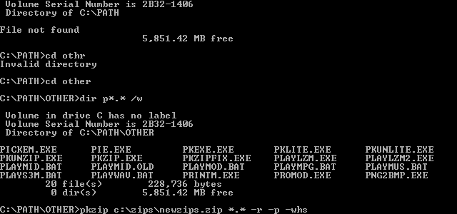
DOS

Slide 23
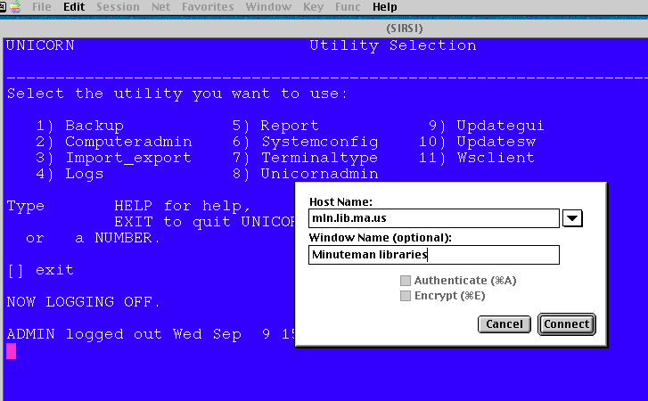
Telnet

Slide 24
Menus
Set of options displayed on the screen
Options visible
  less recall - easier to use
  rely on recognition so names should be meaningful
Selection by:
  numbers, letters, arrow keys, mouse
  combination (e.g. mouse plus accelerators)
Often options hierarchically grouped
  sensible grouping is needed
Restricted form of full WIMP system
Notes:
1

Slide 25
Natural language
Familiar to user
speech recognition or typed natural language
Problems
  vague
  ambiguous
  hard to do well!
Solutions
  try to understand a subset
  pick on key words

Slide 26
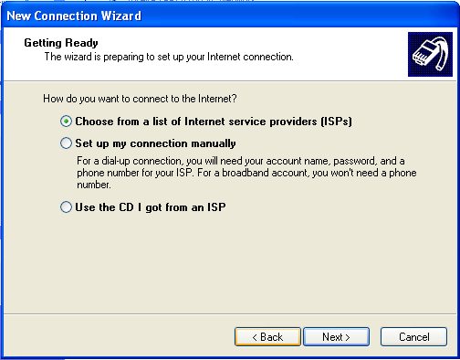
Query Interfaces
Question/answer interfaces
  user led through interaction via series of questions
  suitable for novice users but restricted functionality
  often used in information
  systems

Slide 27
Query Interfaces
Query languages (e.g. SQL)
  used to retrieve information from database
  requires understanding of database structure and language syntax, hence requires some expertise
Select from Employee
Where Salary > 30,000

Slide 28
Form-fills
Primarily for data entry or data retrieval
Screen like paper form.
Data put in relevant place
Requires
  good design
  obvious correction
  facilities

Slide 29
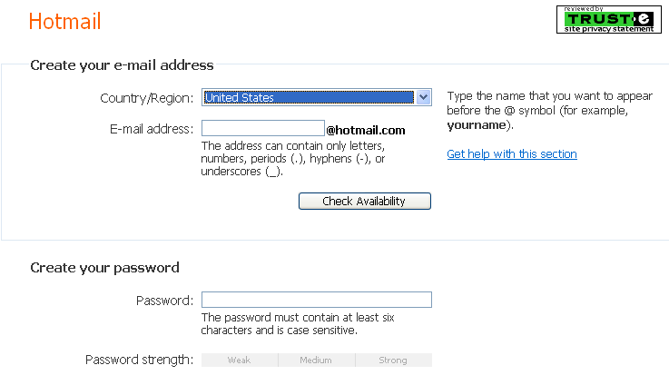
Form-fills

Slide 30
Spreadsheets
first spreadsheet VISICALC, followed by Lotus 1-2-3
MS Excel most common today
sophisticated variation of form-filling.
  grid of cells contain a value or a formula
  formula can involve values of other cells
  e.g. sum of all cells in this column
  user can enter and alter data spreadsheet maintains consistency

Slide 31
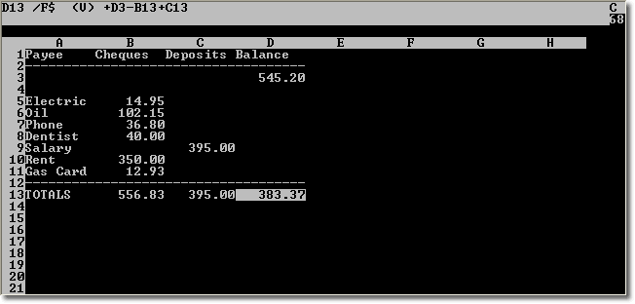
VISICALC

Slide 32
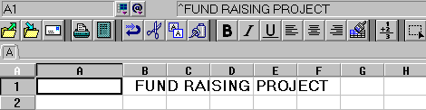
Lotus 1-2-3

Slide 33
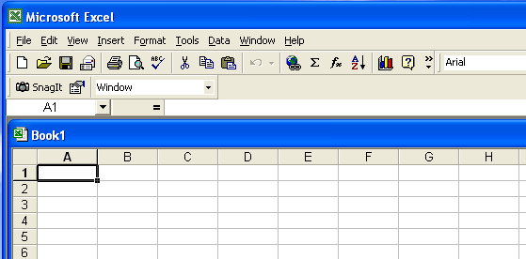
MS Excel

Slide 34
WIMP Interface
Windows
Icons
Menus
Pointers
… or windows, icons, mice, and pull-down menus!
default style for majority of interactive computer systems, especially PCs and desktop machines

Slide 35
Point and Click Interfaces
used in ..
  multimedia
  web browsers
  hypertext
just click something!
  icons, text links or location on map
minimal typing

Slide 36
Three Dimensional Interfaces
virtual reality
‘ordinary’ window systems
  highlighting
  visual affordance
  indiscriminate use
  just confusing!
3D workspaces
  use for extra virtual space
  light and occlusion give depth
  distance effects

Slide 37
Elements of the WIMP Interface
windows, icons, menus, pointers
buttons, toolbars,
palettes, dialog boxes

Slide 38
Windows
Areas of the screen that behave as if they were independent
  can contain text or graphics
  can be moved or resized
  can overlap and obscure each other, or can be laid out next to one another (tiled)

Slide 39
Windows
scrollbars
title bars

Slide 40
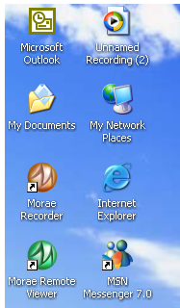


Icons
small picture or image
represents some object in the interface
  often a window or action
windows can be closed down (iconised)
  small representation ﬁ many accessible windows
icons can be many and various
  highly stylized
  realistic representations.

Slide 41
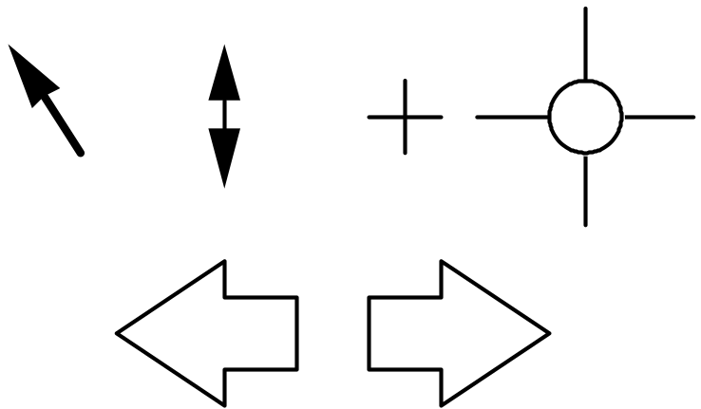
Pointers
important component
  WIMP style relies on pointing and selecting things
uses mouse, trackpad, joystick, trackball, cursor keys or keyboard shortcuts
wide variety of graphical images

Slide 42
Menus
Choice of operations or services offered on the screen
Required option selected with pointer

Slide 43
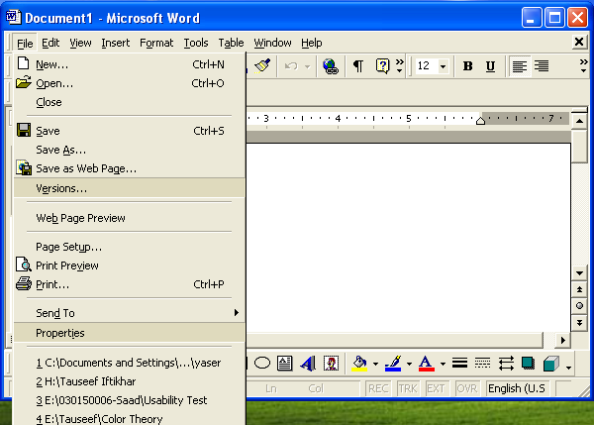
Menus
problem – take a lot of screen space
solution – pop-up: menu appears when needed

Slide 44
Kinds of Menus
Menu Bar at top of screen (normally), menu drags down
  pull-down menu - mouse hold and drag down menu
  drop-down menu - mouse click reveals menu
  fall-down menus - mouse just moves over bar!
Contextual menu appears where you are
  pop-up menus - actions for selected object
  pie menus - arranged in a circle
    easier to select item (larger target area)
    quicker (same distance to any option)
    … but not widely used!

Slide 45
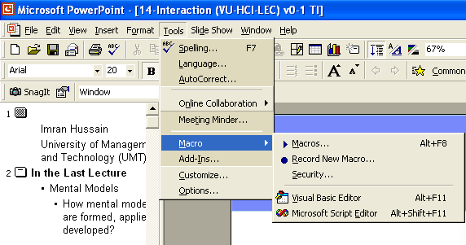
Pull-down Menu

Slide 46
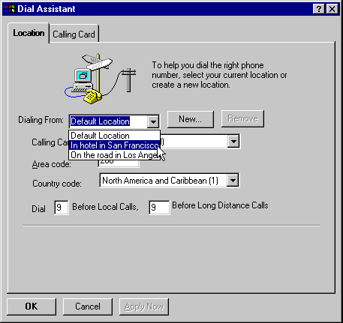
Drop-down Menu

Slide 47
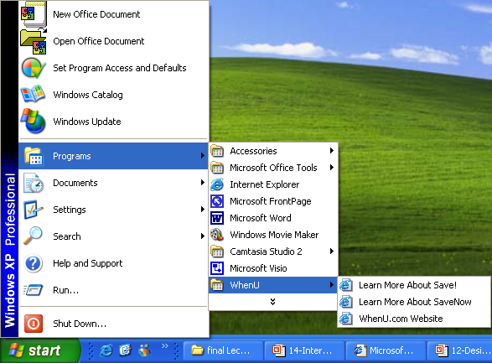
Fall-down Menus

Slide 48
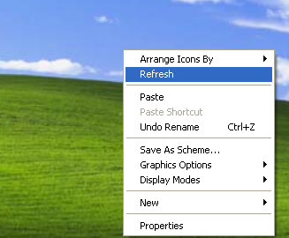
Pop-up Menus

Slide 49
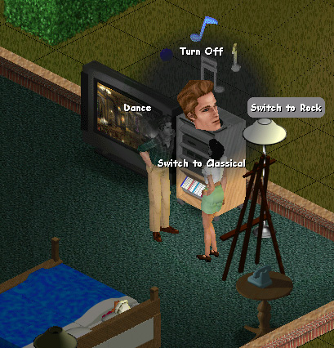
Pie Menu

Slide 50
Menus Extras
Cascading menus
  hierarchical menu structure
  menu selection opens new menu
  and so in ad infinitum
Keyboard accelerators
  key combinations - same effect as menu item
  two kinds
    active when menu open – usually first letter
    active when menu closed – usually Ctrl + letter
  usually different

Slide 51
Keyboard Accelerators
Alt
+
T

Slide 52
Menus Design Issues
which kind to use
what to include in menus at all
words to use (action or description)
how to group items
choice of keyboard accelerators

Slide 53
Buttons
individual and isolated regions within a display that can be selected to invoke an action
Special kinds
  radio buttons
  – set of mutually exclusive choices
  check boxes
  – set of non-exclusive choices

Slide 54
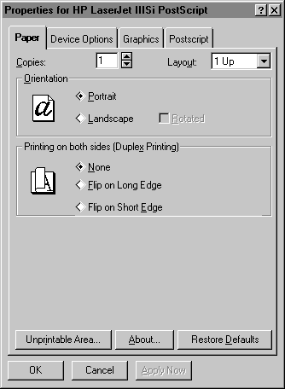
Radio Buttons

Slide 55
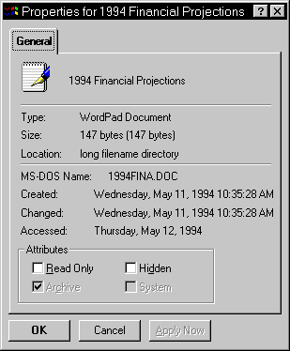
Check Boxes

Slide 56
Toolbars
long lines of icons …
… but what do they do?
fast access to common actions
often customizable:
  choose which toolbars to see
  choose what options are on it

Slide 57
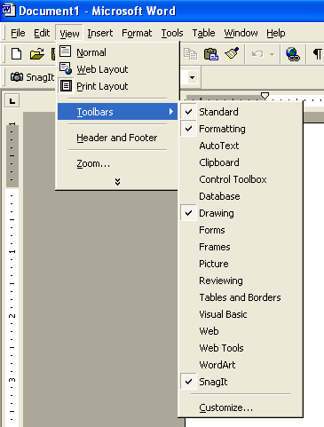
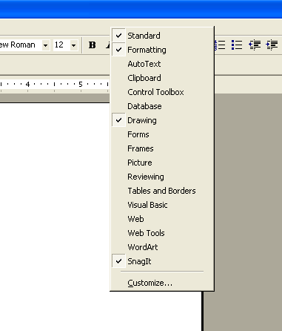
Customization

Slide 58
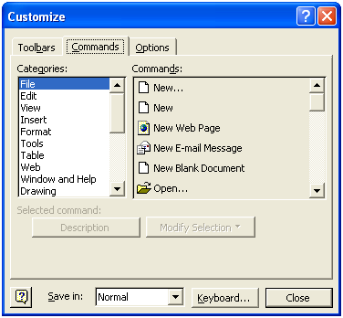
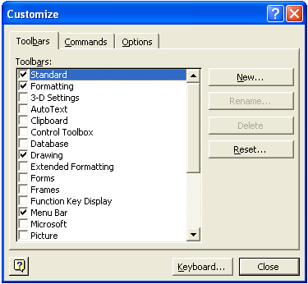
Customization

Slide 59
Palettes and Tear-off Menus
Problem
menu not there when you want it
Solution
palettes – little windows of actions
  shown/hidden via menu option
  e.g. available shapes in drawing package
tear-off and pin-up menus
  menu ‘tears off’ to become palette

Slide 60
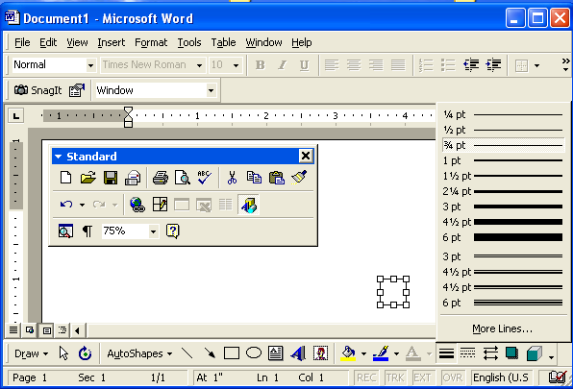
Palettes and Tear-off Menus

Slide 61
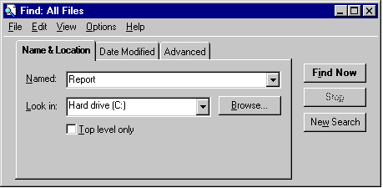
Dialogue Boxes
information windows that pop up to inform of an important event or request information.

